Slide 1
Lecture 7 THE MEDIEVAL AND RENAISSANCE PLANNING

Slide 2
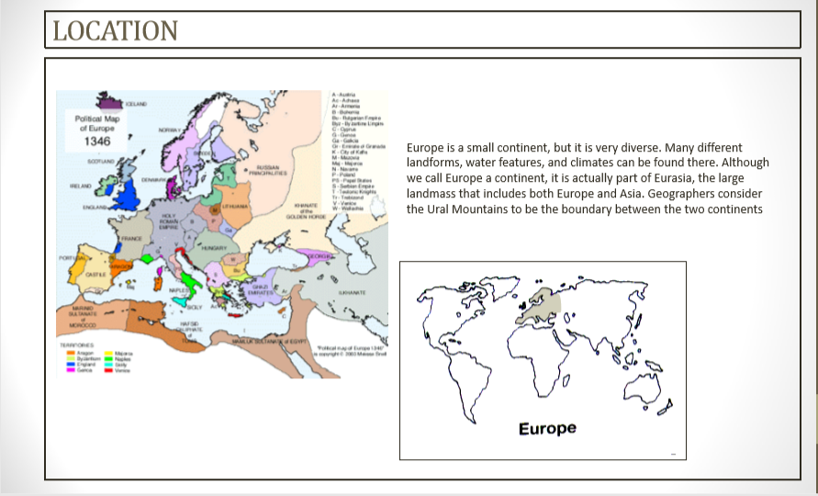
Medieval Town
The medieval era, often called Middle ages or Dark ages , just began before 500 A.D. following a great loss of power throughout Europe by the Roman emperor. The Middle Ages span roughly 1,000 years, ending around 1450 A.D.
Medieval actually means “Middle”.

Slide 3
Significance of Medieval Town

Slide 4
Geography

Slide 5
Political Background

Slide 6
Architectural Character of the cities

Slide 7
The Plan of Medieval Town
Every medieval town was dominated by the church or monastery and castle of lords.
For protective measures, towns were sited in irregular terrain , occupying hill tops or islands, towns assumed informal; and irregular character.
Irregular pattern in planning was devised to confuse enemies; as enemies unfamiliar with town.
Church Plaza became a market place
Castle was surrounded by wall and moat as protective elements.
Open spaces, streets , plazas developed as integral part of site

Slide 8
The Plan of Medieval Town
Roads generally radiated from church plaza and market places to gates with secondary lateral roadways connecting them.
With the exception of few main roads between the gates and market places, streets were used for pedestrian circulation.
Circulation and building spaces were modelled to irregular features and naturally assumed an informal character.
Distinction between town and country was sharp, and this demarcation and the small size of the city provided ready access to open countryside in time of peace.
Some towns are planned in which straight streets were intersecting at right angles, and thus enclosing rectangular blocks. In this houses aligned along each side.

Slide 9
The Medieval Dwellings
Due to restricted area of town houses were built in the connected rows along narrow street.
Open spaces in which domestic animals were kept and garden cultivated was reserved behind these rows.
The average dwelling two stories in height. The work room and storage room were on the first floor or basement. Sometimes kitchen was also located here.
Living, dining took place on second floor.
Masonry was the usual construction, although wood frame filled with wattle & clay & roofed with thatch also existed.
A dormitory was located in tower.
The windows had no glass and were protected with shutter.
A drain pipe was imbedded in the wall for disposal of waste.

Slide 10
Town Planning: Carcassonne

Slide 11
Town Planning: Carcassonne

Slide 12
Renaissance: Location
Renaissance began in Florence, Italy in the early fifteenth century, encompassing Rome and Milan, Netherlands, and spread to the rest of Europe and after 125yrs it reached France.
The Renaissance began to spread after 1500s to England, Germany, France, Spain, Poland, and the Netherlands.

Slide 13
Significance
Perspective was commenced in city planning in order to create symmetrical buildings that led to a form of beauty making the Renaissance cities distinctive and unique from their Medieval antecedents.
The urban centers of this generation also carried a purpose exceeding that of purely a residence – as an art gallery to showcase the artistic taste of its partisans.
Architects of the Renaissance age began to move away from the Gothic style that had originated from France and turn to more older Roman styles.

Slide 14
Technological achievement and its reflection in planning
The Roman construction technologies of domes, vaults,
Order of columns, arches and arcades was the base of this new style of architecture
The Roman had their own column order as the Greek.

Slide 15
Technological achievement and its reflection in planning
Renaissance means ‘awakening’ or ‘revival’.
The architecture style is basically the revival of roman architecture.
The artists of the renaissance era were searching the ways of reviving and absorbing the methods of construction of roman architecture , that lead in the new form of architecture.

Slide 16
Technological achievement and its reflection in planning
To increase the strength to the structure the architect used a herring bone pattern of bricks.
The base of the dome is supported by the sandstone chain and holds the walls of the dome.
The pantheon can be related to the structure due to the coffered ceiling, the oculus and the use of arches.

Slide 17
Architectural character of the cities
Features of Renaissance Buildings:
Symmetrical arrangement of windows and doors.
Extensive use of classical columns and pilasters.
Triangular pediments.
Arches.
Domes.

Slide 18
Architectural character of the cities
PLAN - Renaissance buildings have a square, symmetrical appearance in which proportions are usually based on a module.
FACADE - Façades are symmetrical around their vertical axis.
COLUMNS AND PILASTERS – used either as structural, supporting an arcade or architrave, or purely decorative, set against a wall in the form of pilasters.
ARCHES - Arches are semi-circular .Arches are often used in arcades
DOMES - is used frequently, both as a very large structural feature that is visible from the exterior, and also as a means of roofing smaller spaces where they are only visible internally.
CEILINGS - refitted with flat or coffered ceilings. They are not left open as in Medieval architecture. They are frequently painted or decorated.
St.Peters basilica
Santa maria novella
Pazzi chapel

Slide 19
Radial streets extend outward from a defined centre

